Slide 1
UNIT 6
Lecture 33
Classroom Happiness and Employees Happiness
Learning Outcomes
To Understand the concept of personal strengths
To apply laws of positive psychology in real life situation.

Slide 2
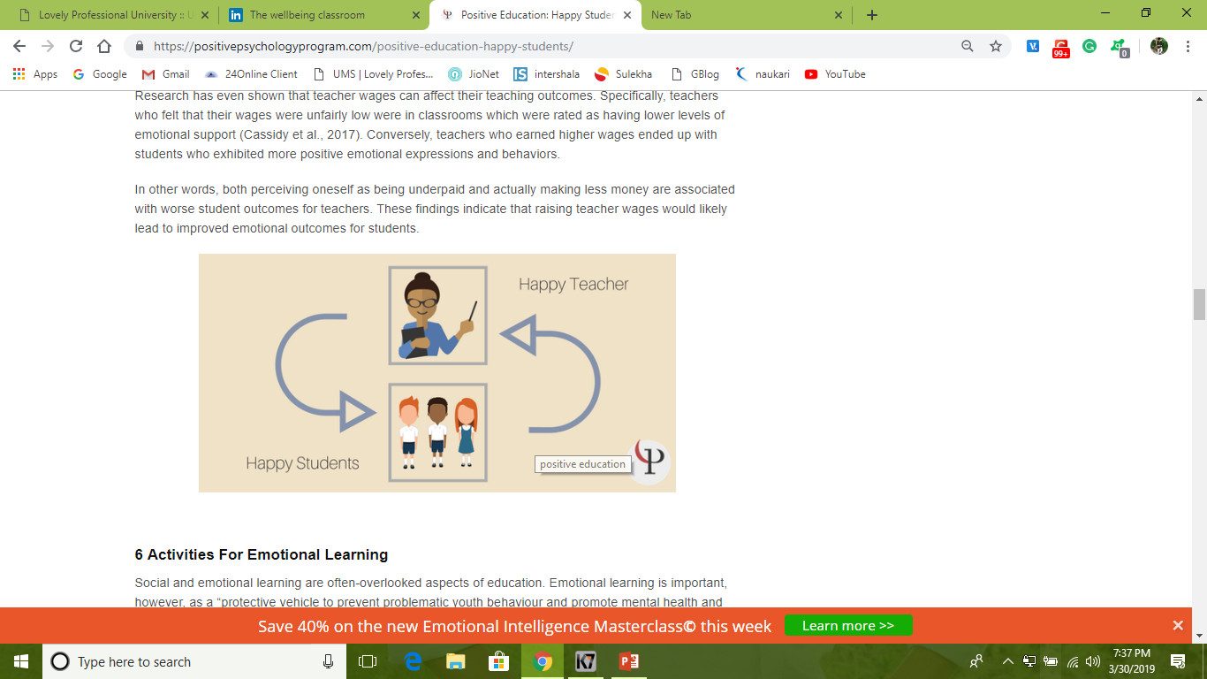
Happy Teacher = Happy Class
Positive education is not just for the sake of the students.
One commenter has argued that not only should student happiness be the aim of education, but that teacher happiness should also be the aim of education.
This author also claims that happy teachers will directly lead to happy students, by helping their students associate education with happiness, as the teachers do.

Slide 3
6 Activities For Emotional Learning
Identifying personal sources of happiness
Expressing gratitude
Free expression of different feelings in movement, art, speech, and facial expressions
Describing happy memories
Morning Meeting (Starting every morning with a class meeting where students can share about their weekends, or teachers can share a message, or some other activity)
Academic Choice (Giving students multiple choices to reach some educational goal, such as giving an option between writing an essay on a topic, or making a video on that topic, or giving a speech on that topic, or some other form of learning

Slide 4
Positive Teaching: Mood trackers And Other Worksheets
Positive Steps to Wellbeing :
This one-page worksheet is simply a list of things to keep in mind for well-being. It includes tips on keeping perspective, exercising, relaxing, sleeping, connecting with others, and more.
Three Good Things Worksheet :
This is a worksheet for the Three Good Things exercise, which asks someone to list three good things that happened to them every day, and to reflect on those things.

Slide 5
Daily Mood Chart :
This daily mood chat helps students track their mood throughout the day (and can be modified to only include the school day). This simple self-report chart will help students better understand their mood throughout the day and week. Teachers can also use it as a group mood chart to track the class’s engagement levels.

Slide 6
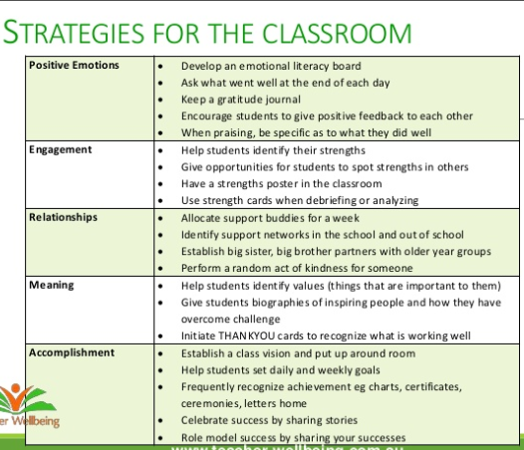
STARTEGIES FOR THE CLASSROOM

Slide 7
10 Ways Teachers Can Create a Positive Learning Environment
Address Student Needs
2. Create a Sense of Order
3. Greet Students at the Door Every Day
4. Let Students Get to Know You
5. Get to Know Your Students
6. Avoid Rewarding to Control
7. Avoid Judging
8. Employ Class-Building Games and Activities
9. Be Vulnerable
10. Celebrate Success

Slide 8
ENCOURAGING EMPLOYEE HAPPINESS

Slide 9
Why Happiness increases productivity
Happier employees work harder
Happy employees give better performance
They Are more loyal (trust)
They are healthier
They Take more risks

Slide 10
Employee can attain their happiness in two ways
Financial | Non – Financial
Pay and allowances | Status
Productivity linked wage incentives: | Organisational Climate
Bonus | Career Advancement Opportunity:
Profit Sharing: | Employee Recognition programme
Retirement Benefits: | Job security
Perquisites: | Employee participation:
 | Employee Empowerment

Slide 11

Ways to keep employees happiness
Recognize their progress
Know what they want to do
Listen and Respond to Their Emotions and Problems
Wish them and give respect
Know Your People ( strengths and weakness)
Be friendly
Appreciate them ( they put more effort next time)

Slide 12
Lets Check????
Perquisites is which way of encouraging employees happiness?
Explain the Academic Choice activity in classroom.
List the three Mood trackers And Other Worksheets.
What do you mean by Organizational Climate?
What is the technique to know ones own strengths and weaknesses?

